Slide 1




Slide 2

GUJARAT POLICE BARRICADE

Slide 3



Slide 4



Slide 5



Slide 6



Slide 7



Slide 8



Slide 9



Slide 10



Slide 11

REFERENCE

Slide 12
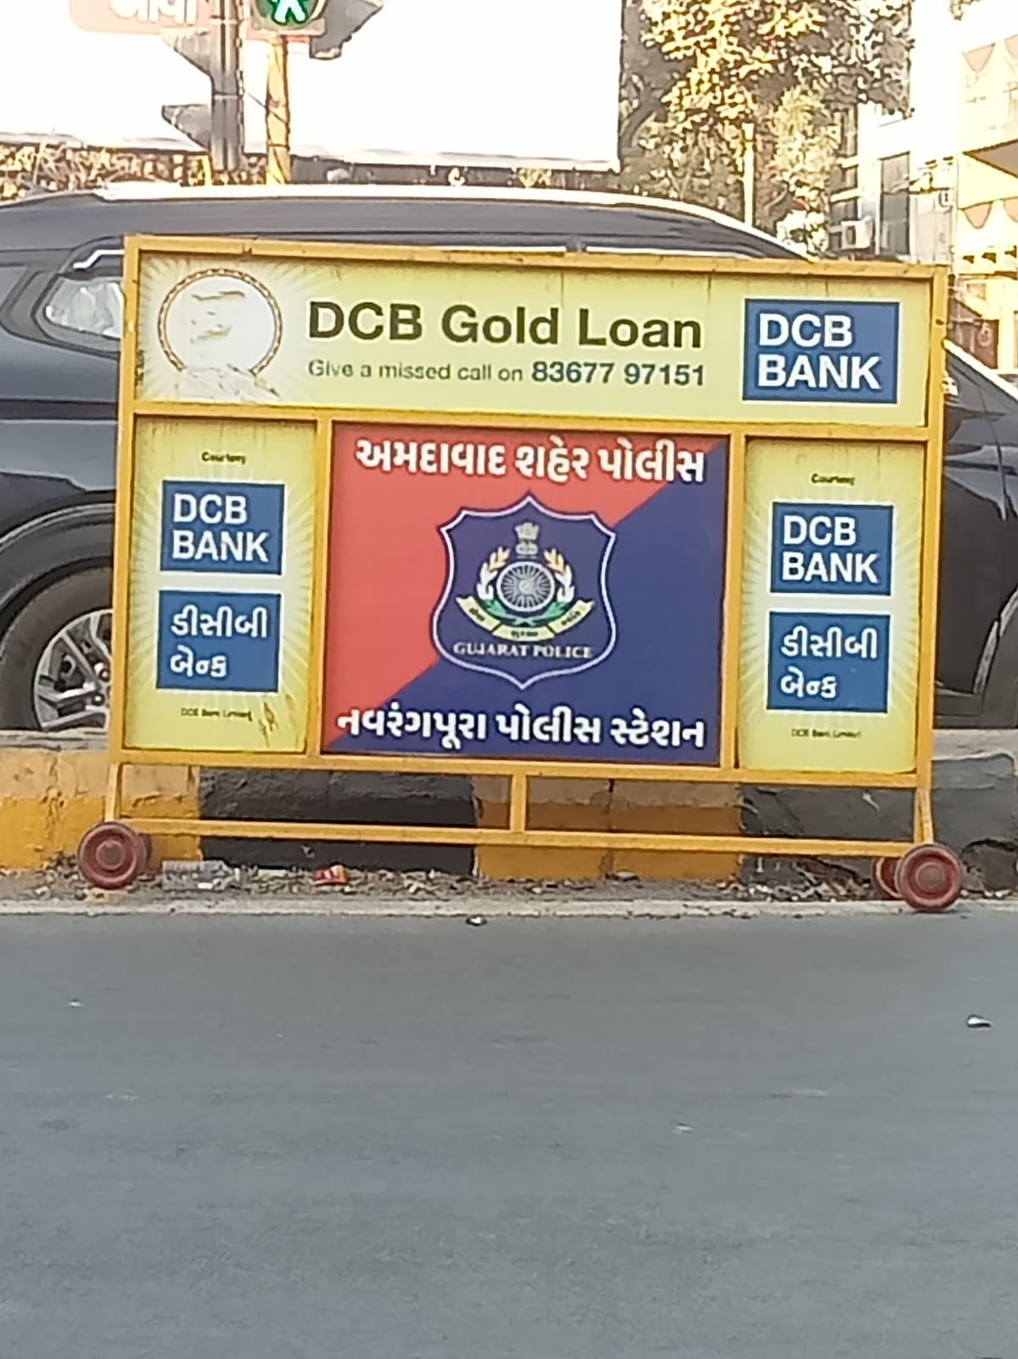
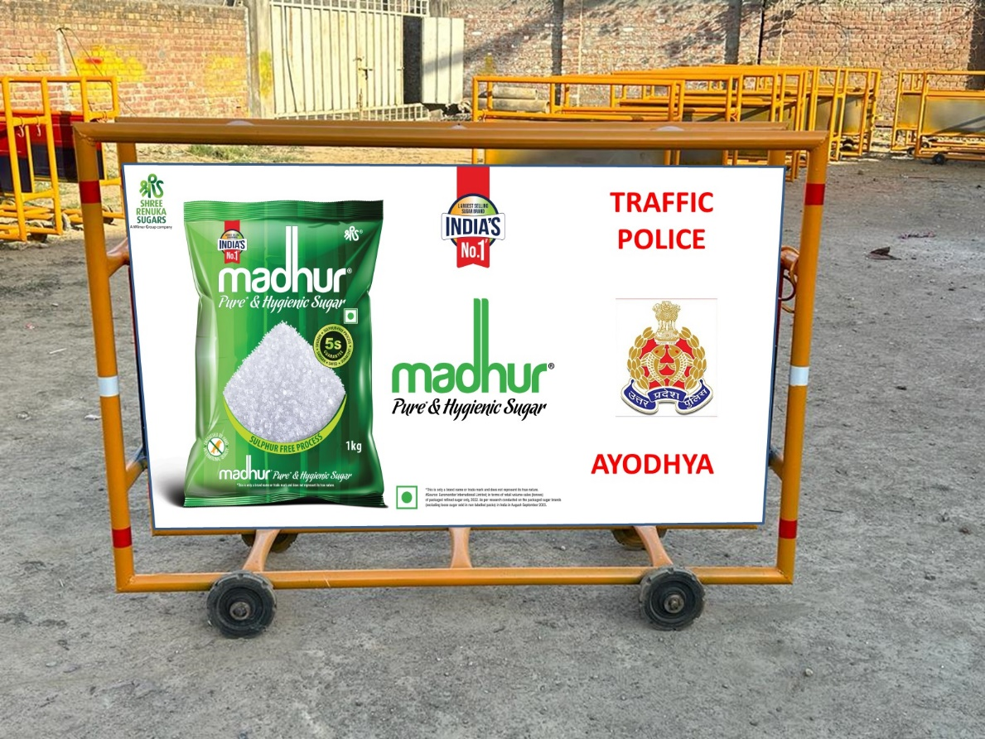
REFERENCE

Slide 13
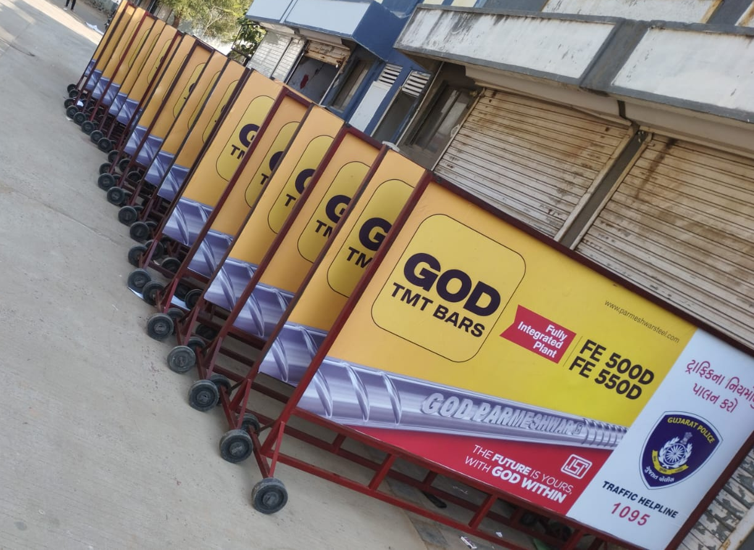
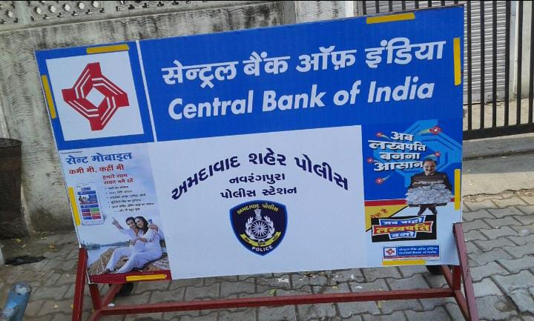
REFERENCE

Slide 14



Dhiraj Chabbria
Director-Marketing
M: +91 98700 79884
Email Id. : dc@sabmarcom.com
LET’S DISCUSS…

